Slide 1


Slide 2

Introduction to Data Analyst and Data Science for Beginners Lecture # 3 Operators in Python
Ehtisham Sadiq

Slide 3

Today’s Agenda
Recap of Previous Lecture
Assignment Solution
Comments in Python
Operators in Python
Arithmetic Operators
Assignment Operators
Comparison Operators
Logical Operators
Bitwise Operators
Identity Operators
Membership Operators

Slide 4

Assignment’s Solution
Demonstration
Assignment_Solution.ipynb

Slide 5
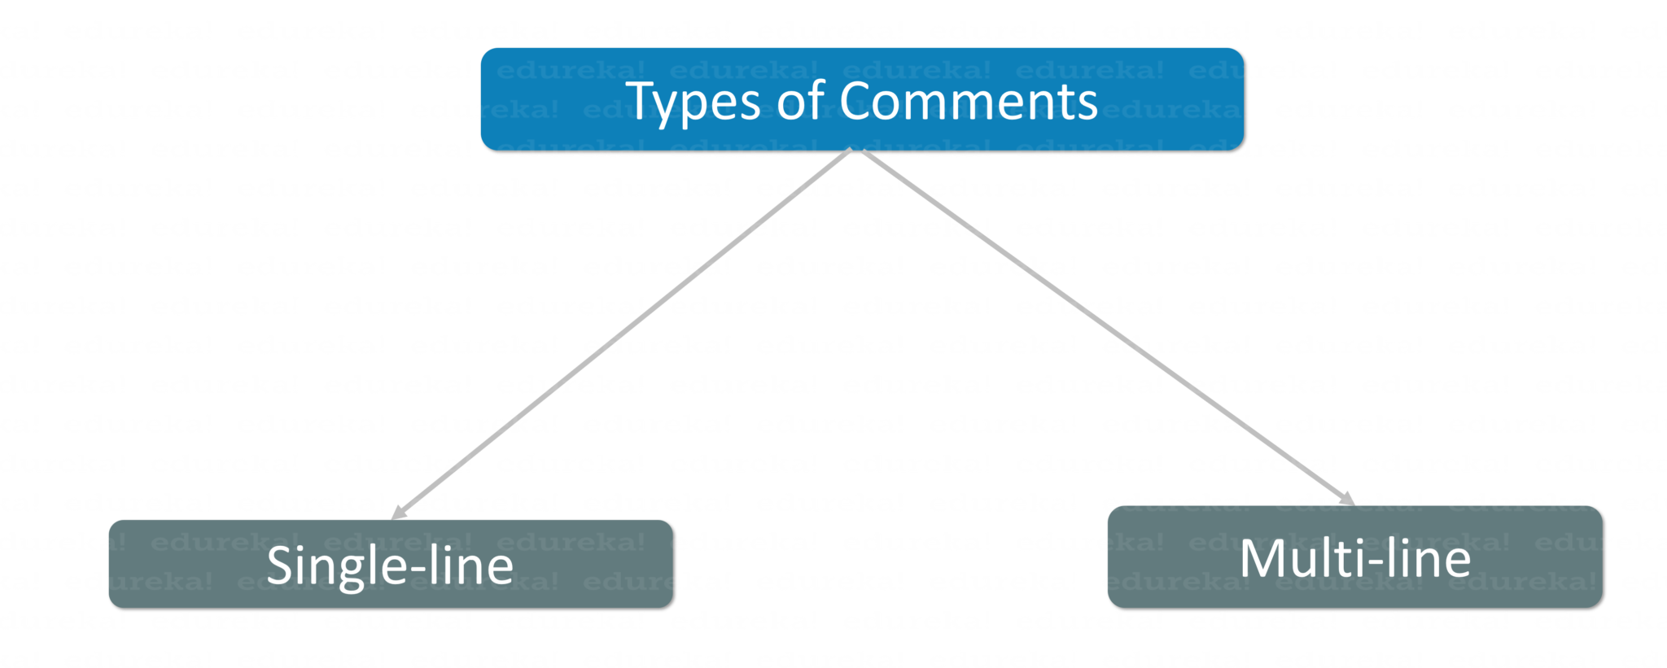
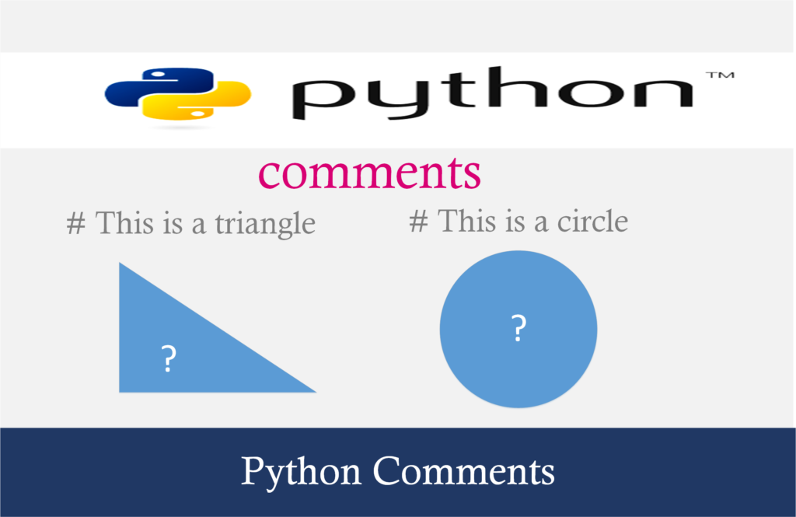
Comments in Python

Slide 6
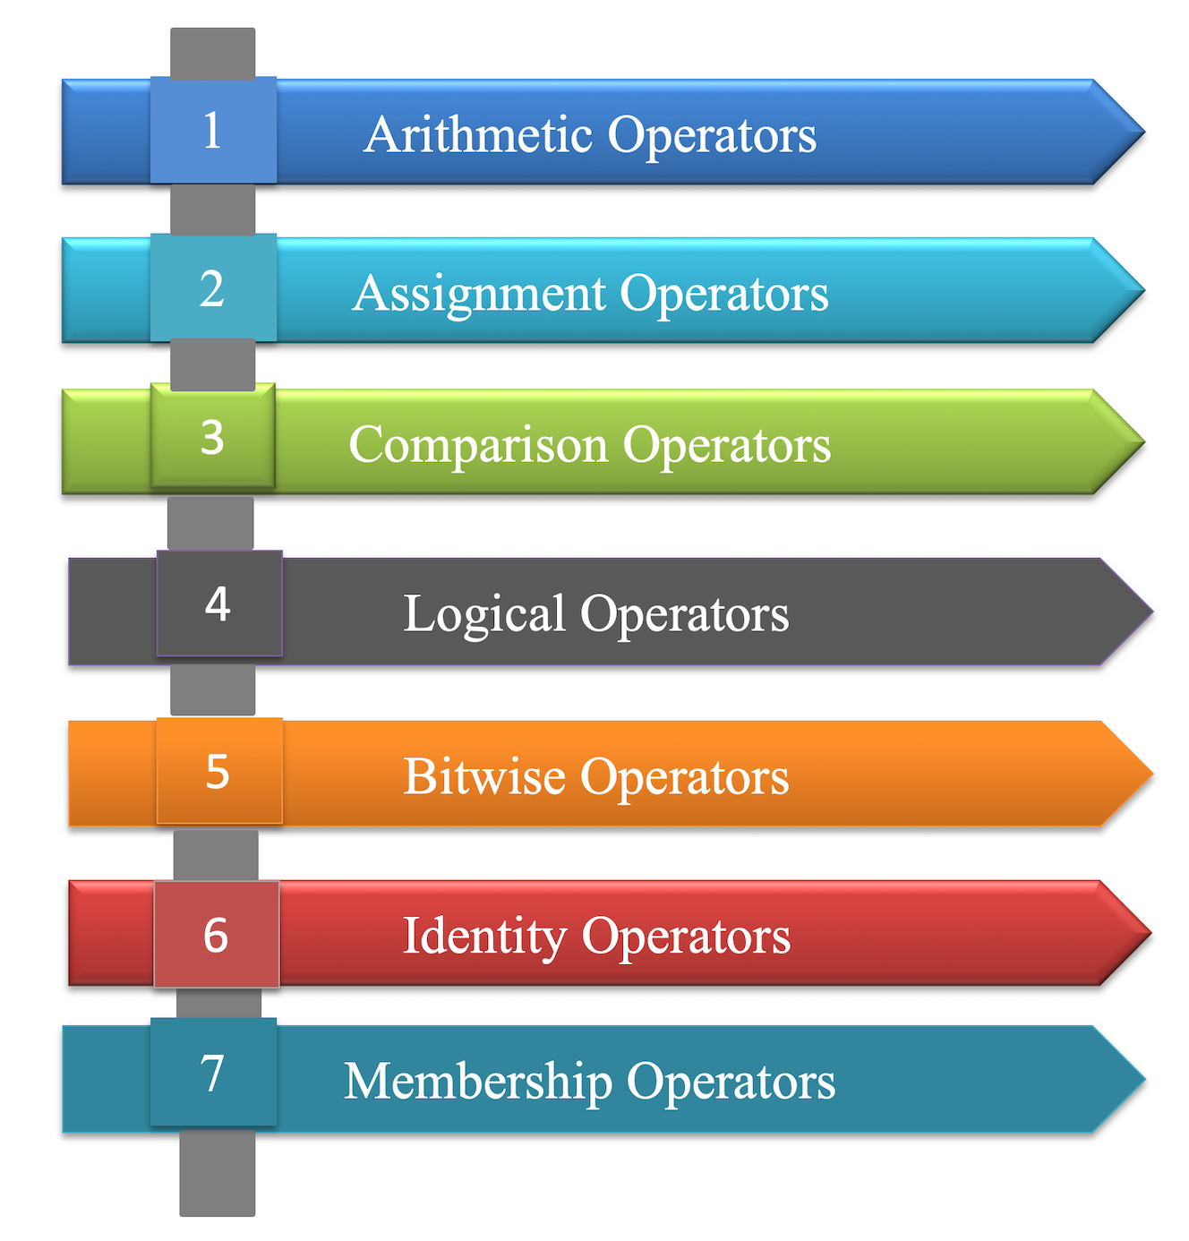
Operators in Python

Slide 7

Any Question?

